Slide 1
TEAM NAME :ACHIEVERS TEAM LEADER:SASIDHAR.K TEAM MEMBERS: REDDY SUDHAN REDDY.P SANDEEP REDDY.B SIVA SAI

Slide 2

MINING THE WWW
(WORLD WIDE WEB)

Slide 3


The World Wide Web was invented by a British scientist, Tim Berners-Lee in 1989.

Slide 4
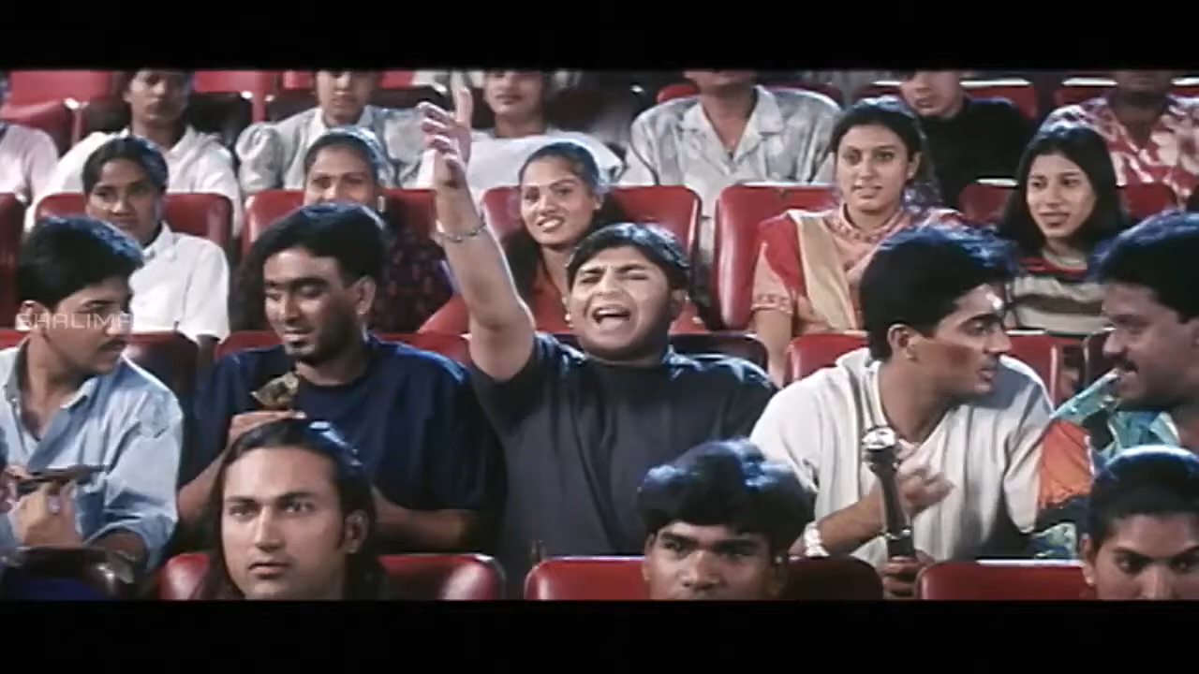

Slide 5
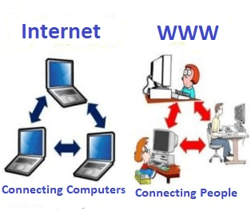

Slide 6
WHAT IS WEB MINING?
Web Mining
Web Mining is the process of Data Mining techniques to automatically discover and extract information from Web documents and services. The main purpse of web mining is to discover useful information from the World Wide Web and its usage patterns.

Slide 7
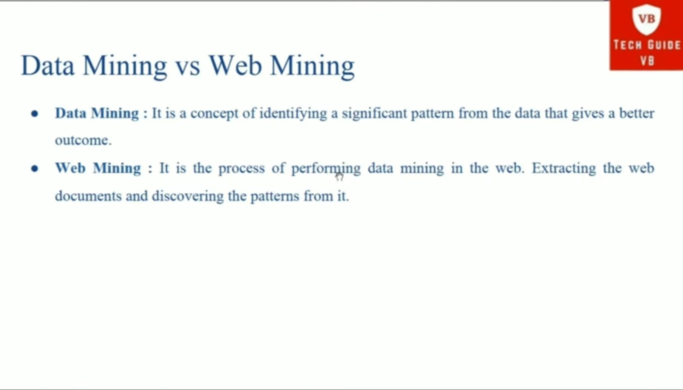

Slide 8
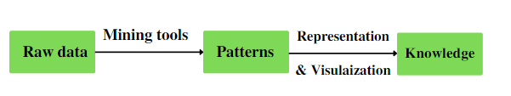
Process of Web Mining

Slide 9
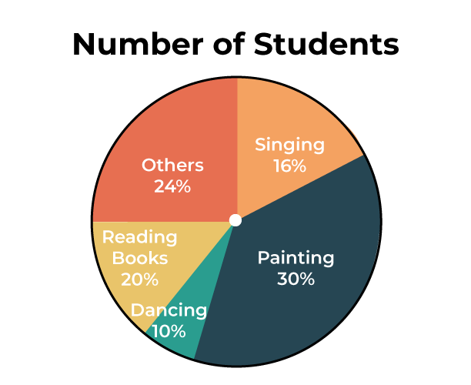

Slide 10
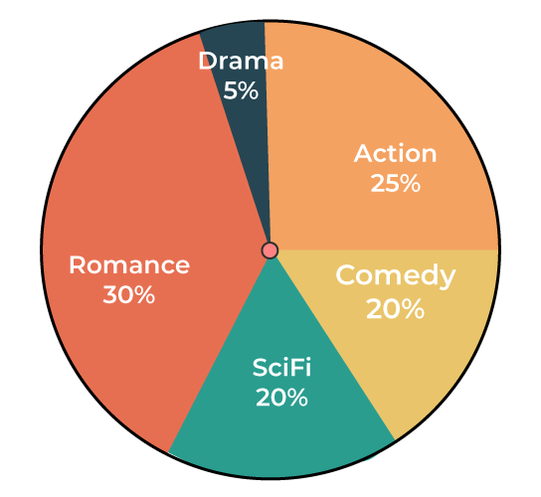
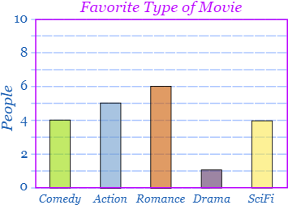

Slide 11
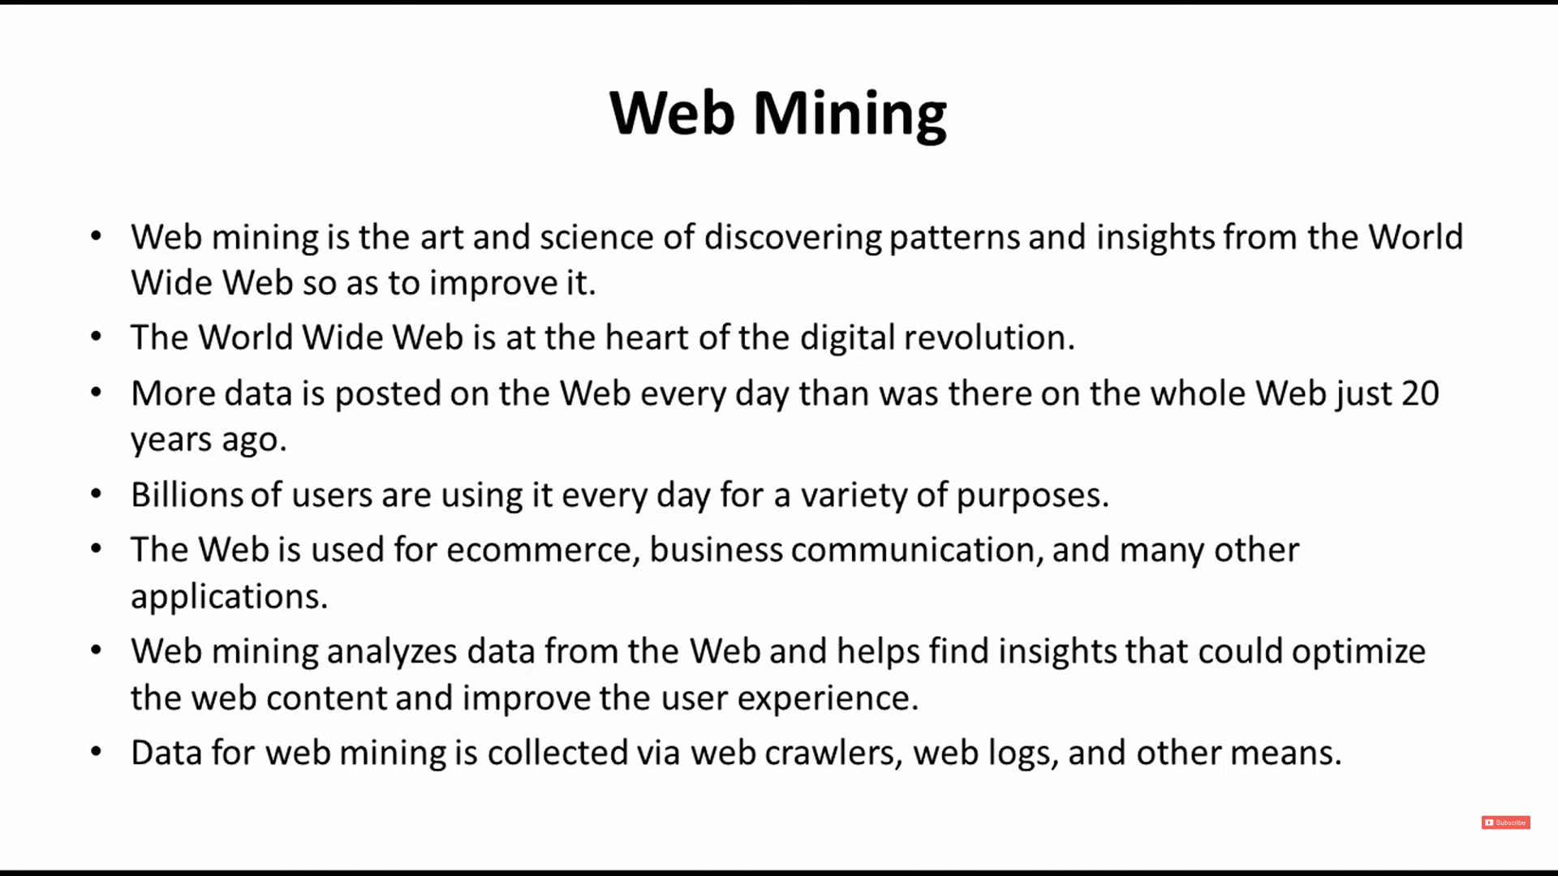

Slide 12
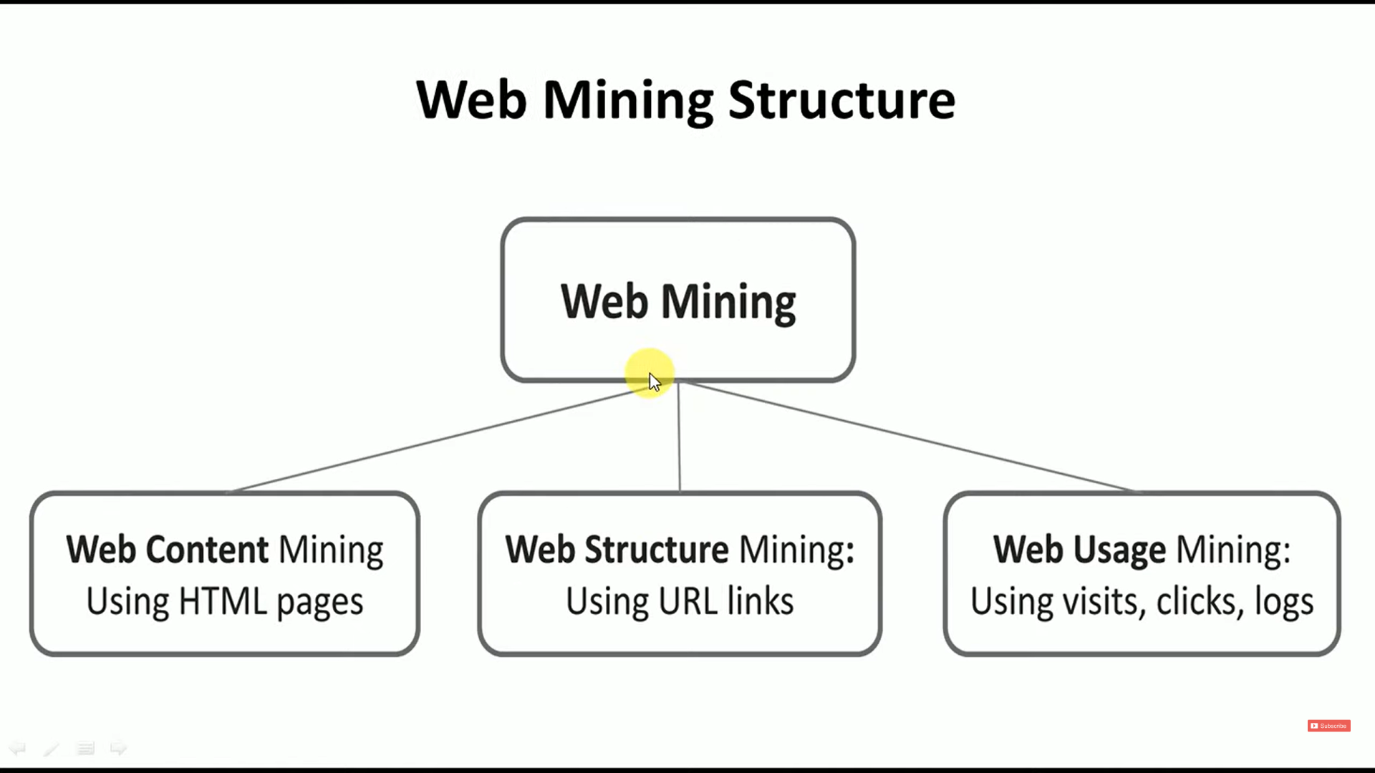

Slide 13
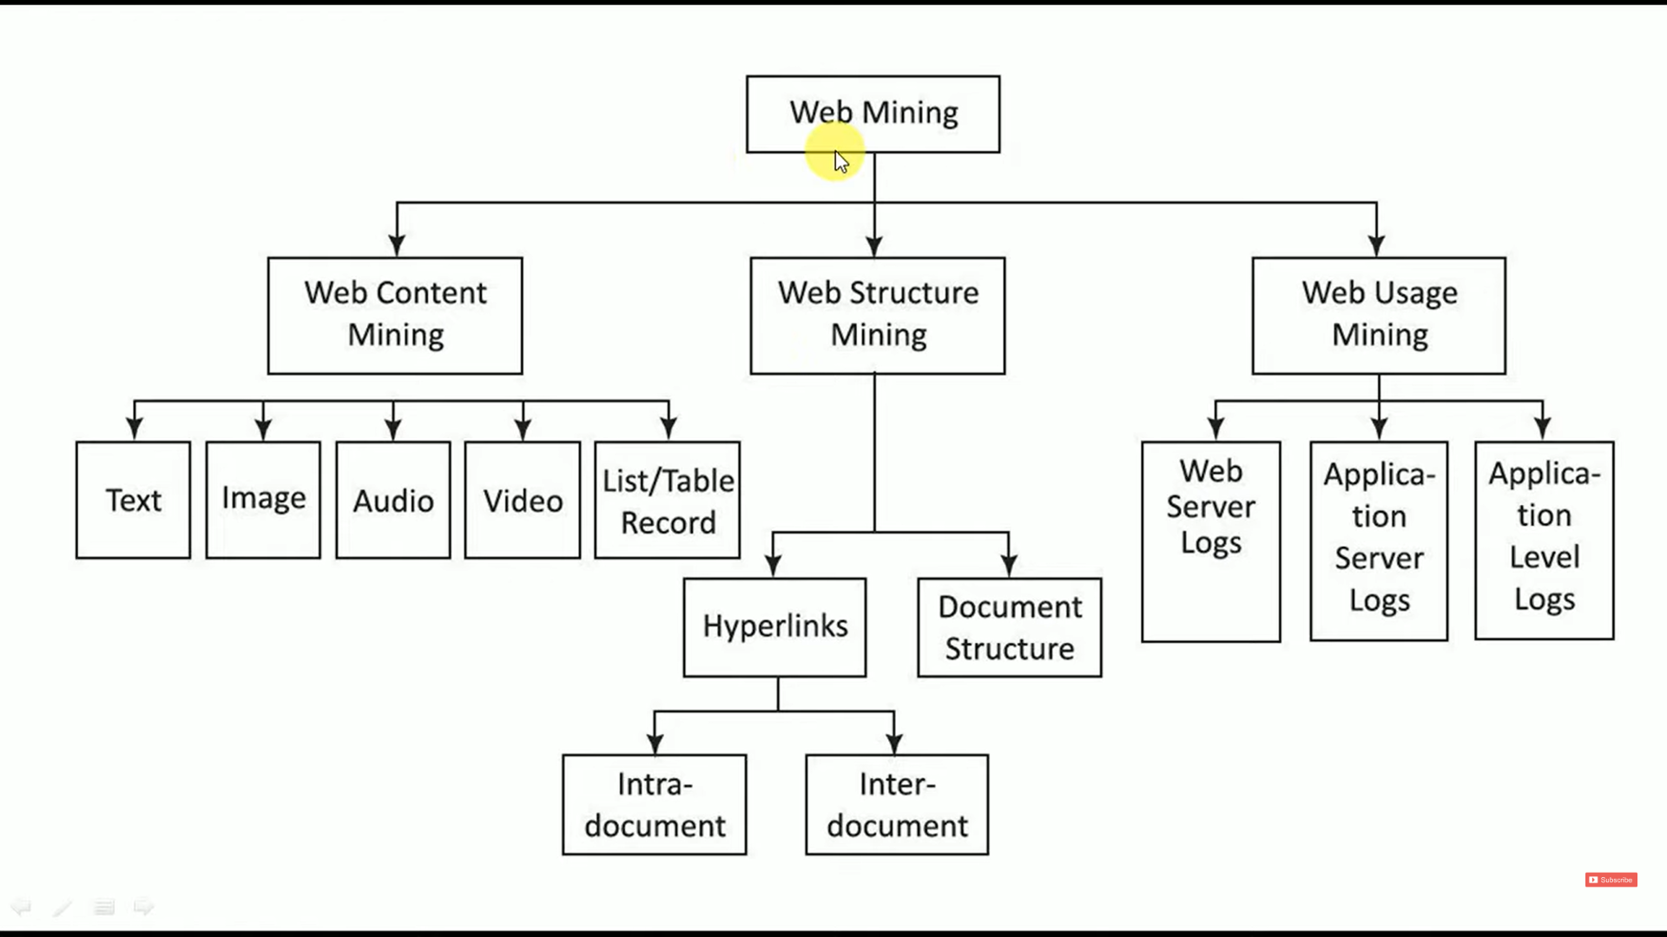

Slide 14
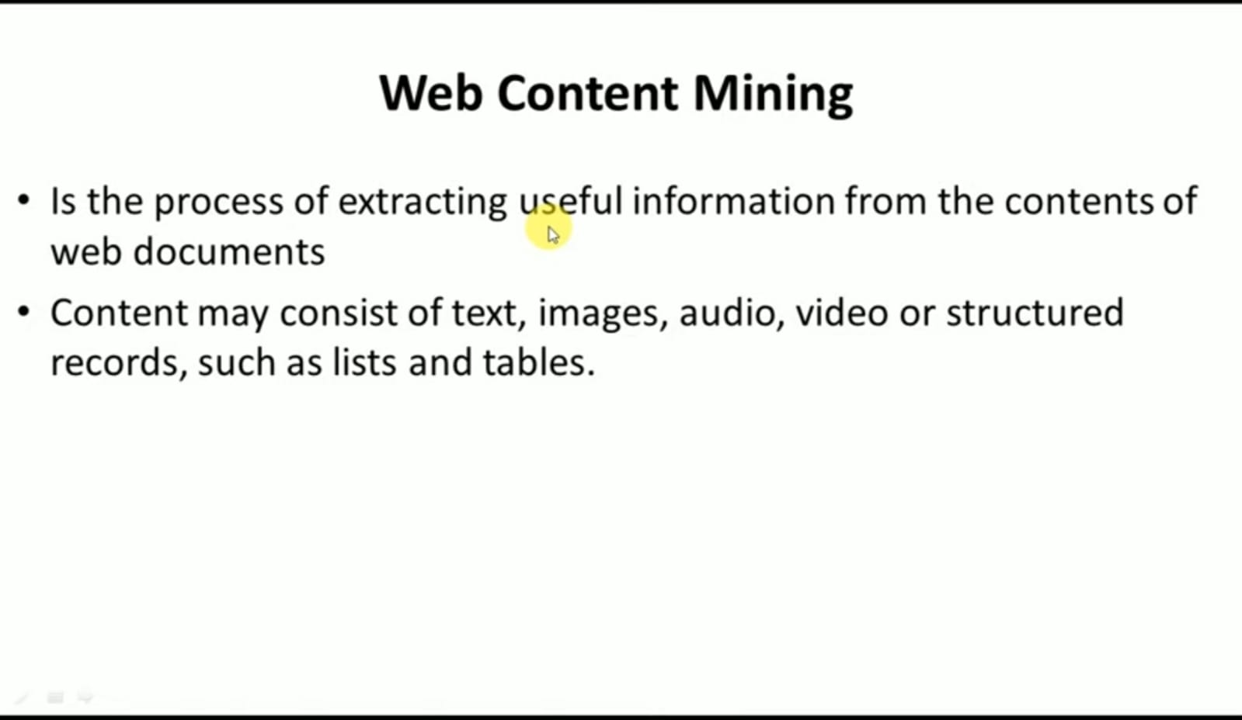

Slide 15


Slide 16
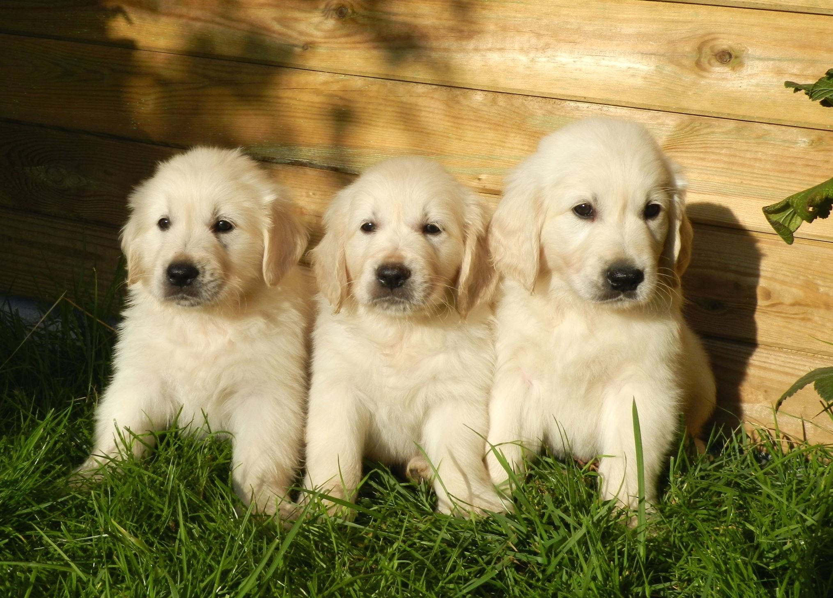

Slide 17


Slide 18
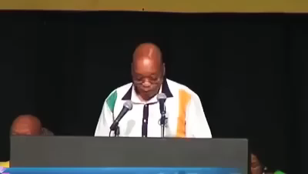

Slide 19
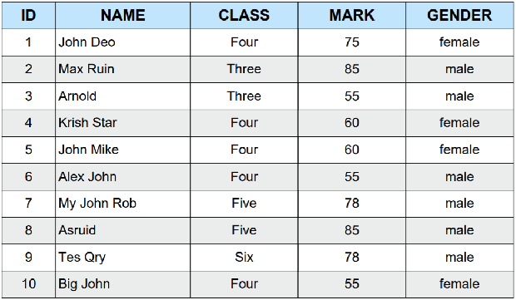

Slide 20
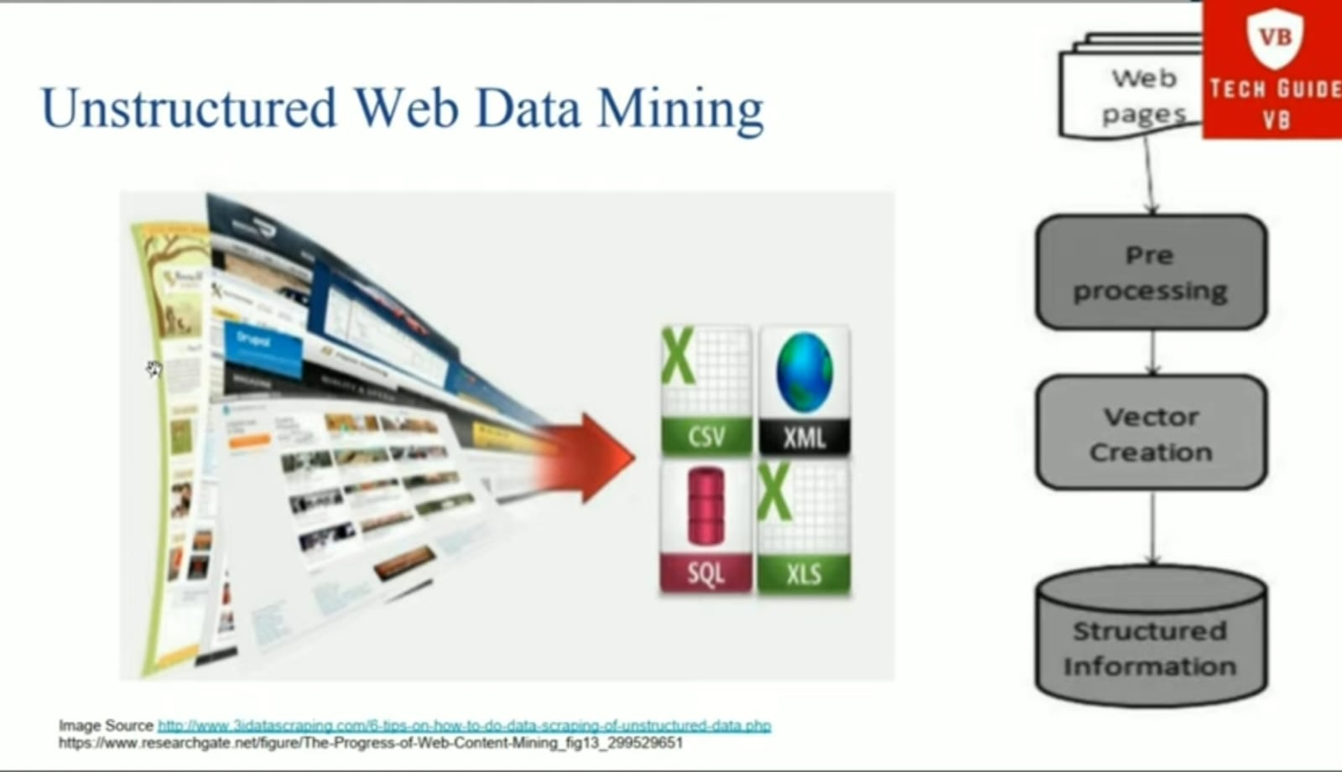

Slide 21
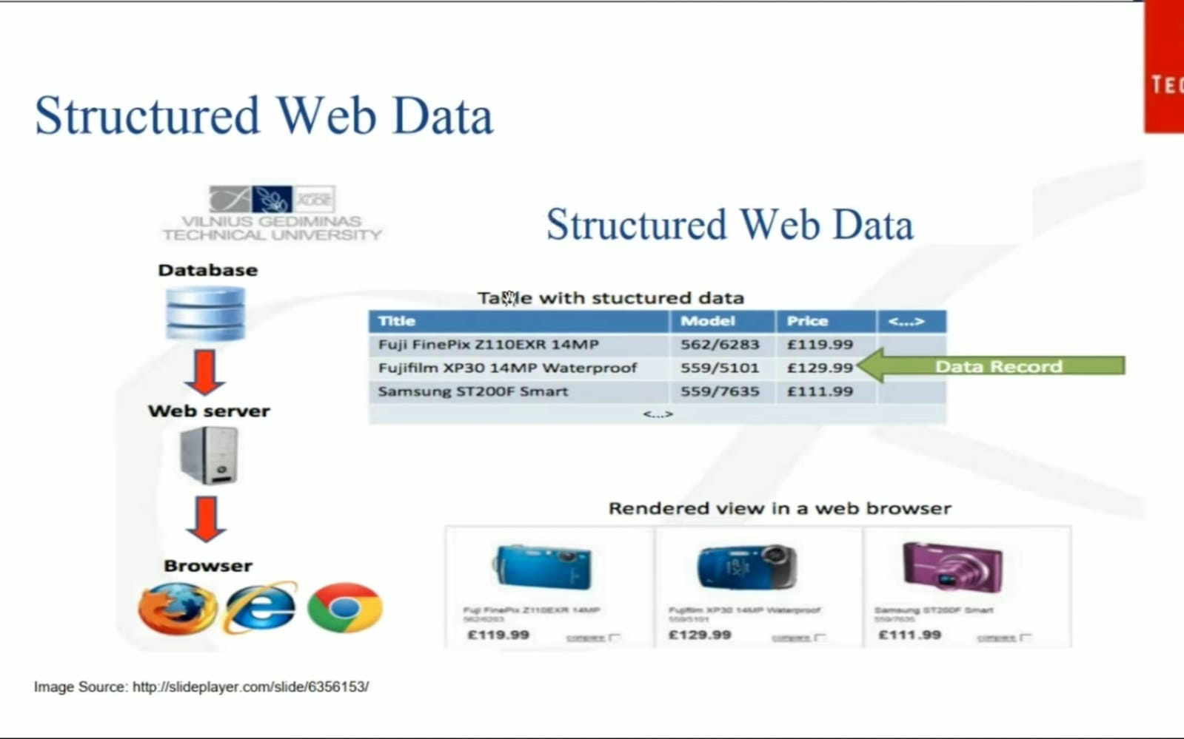

Slide 22
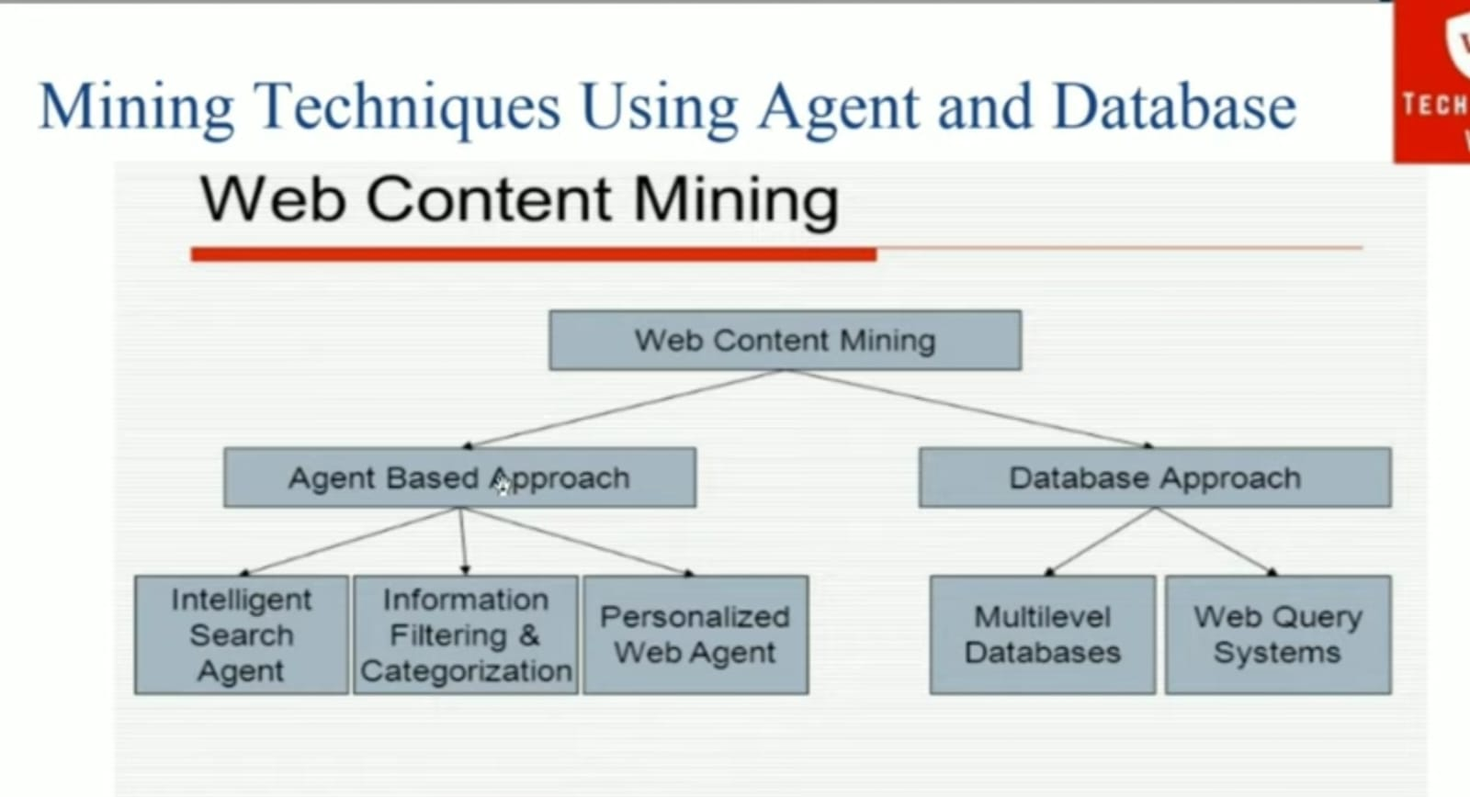

Slide 23
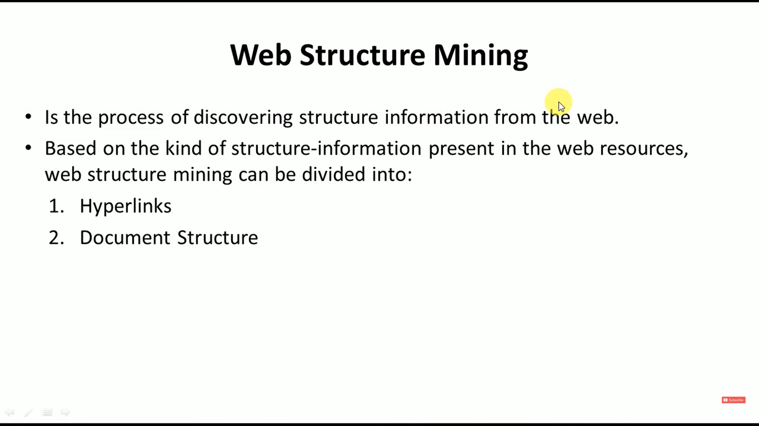

Slide 24





Slide 25


Slide 26
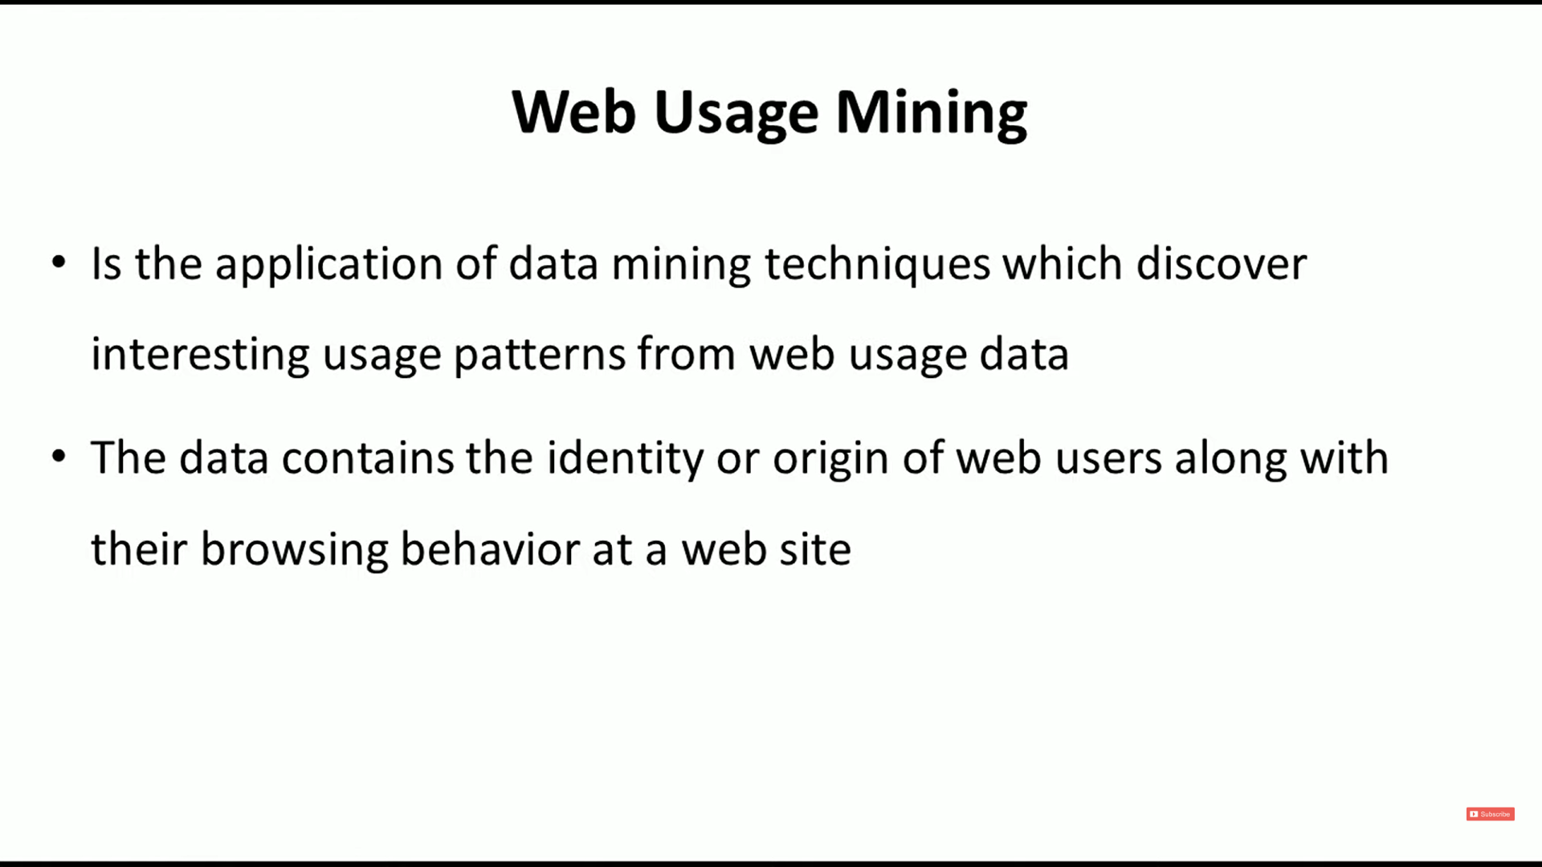

Slide 27
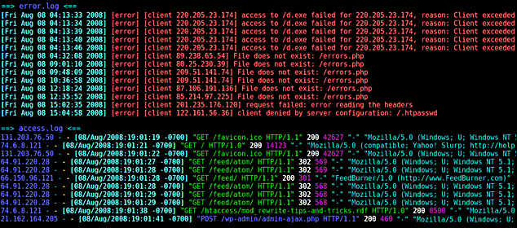
Web Server Logs

Slide 28


Slide 29
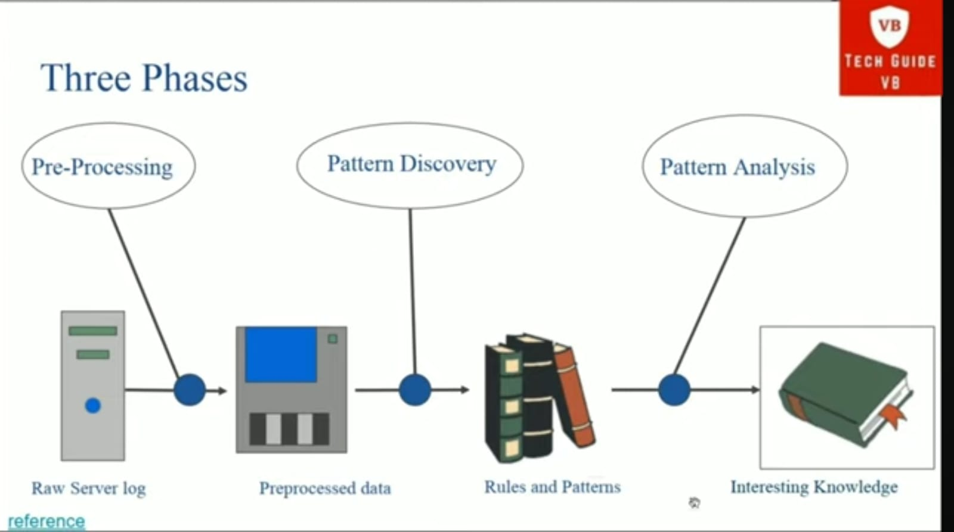

Slide 30



